Slide 1
SMART BIN
WASTE COLLECTION SENSOR MANAGEMENT

Slide 2
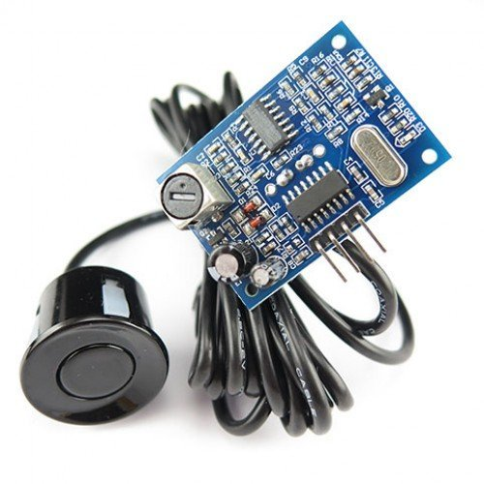
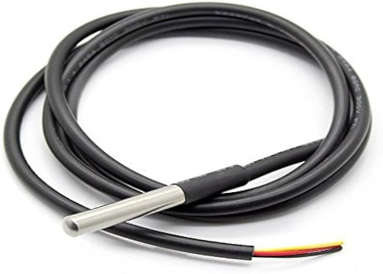
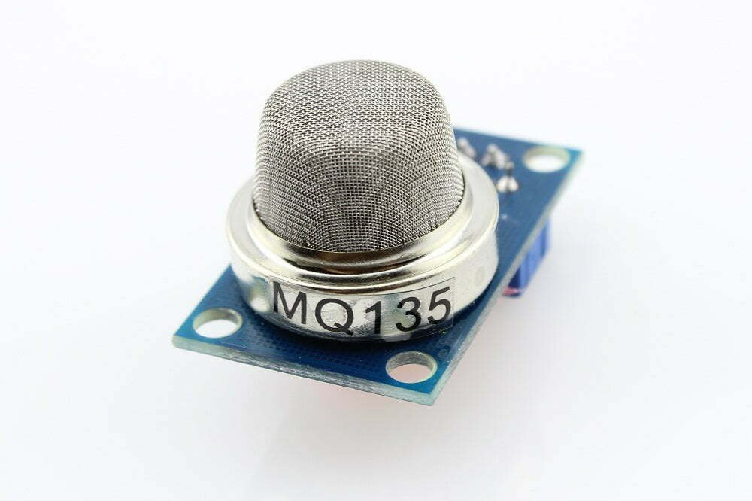
Component of The system
Fill Level Sensor:- We can use Ultrasonic Sensors for this.
The JSN-SR04T Waterproof Ultrasonic Sensor is a good choice for most waste management.
Temperature Sensors: the DS18B20 Waterproof Temperature Sensor is a strong choice due to its durability
Odor Sensors: MQ-135 Gas Sensor is a practical choice for general odor detection in waste bins.
To ensure that the data collected by the sensors can be transmitted over long distances without using much power, we use a communication technology called LoRaWAN

Slide 3
Total Cost for One Bin
1. Fill Level Sensor:
₹400 - ₹600
2. Temperature Sensor:
₹150 - ₹250
3. Odor Sensor:
₹150 - ₹250
4. LoRaWAN Module:
₹1,000 - ₹1,500
5. Microcontroller:
₹500 - ₹800
6. Power Supply (Battery):
₹200 - ₹400
7. Protective Casing:
₹300 - ₹500
The total cost to equip one waste bin with sensors and LoRaWAN technology is approximately ₹2,800 - ₹4,500.

Slide 4
Additional Costs to Consider
LoRaWAN Gateways:
Cost per Gateway: ₹10,000 - ₹15,000
Central Server/Cloud Service:
Monthly cloud service fees could range from ₹500 to ₹2,000, depending on the usage.

